Slide 1
The Internet Protocol

Slide 2
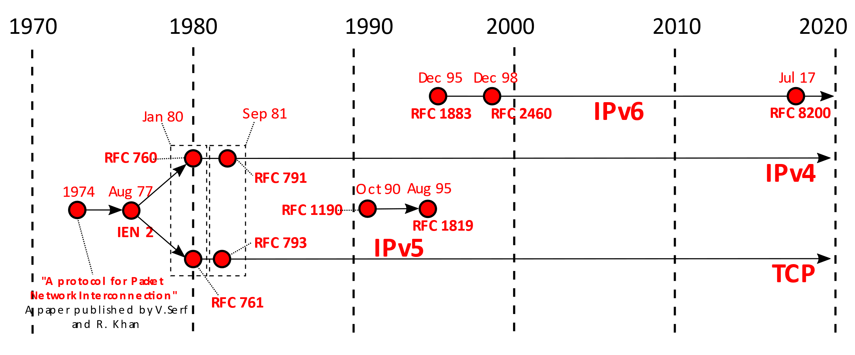
History of IP
By Michel Bakni - V. Cerf; R. Kahn (may 1974) https://tinyurl.com/wkcite?curid=79334079

Slide 3
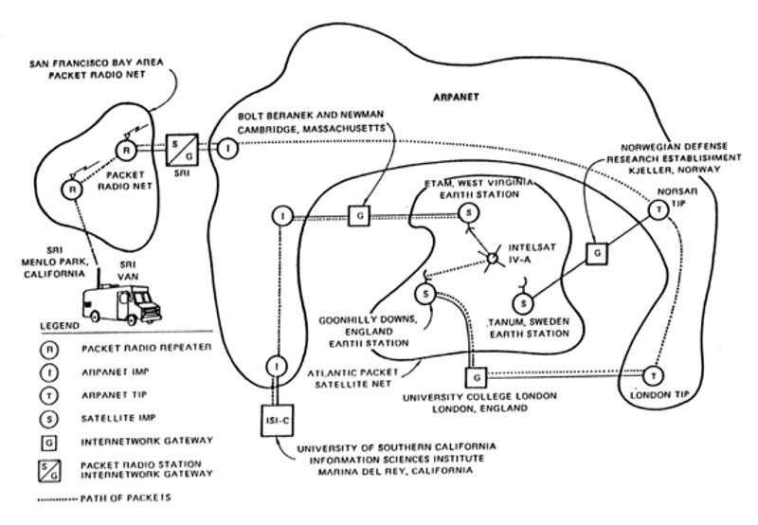
First “Internet”
By Author unknown - Computer History Museum, Public Domain, https://wkcite?curid=78988842

Slide 4
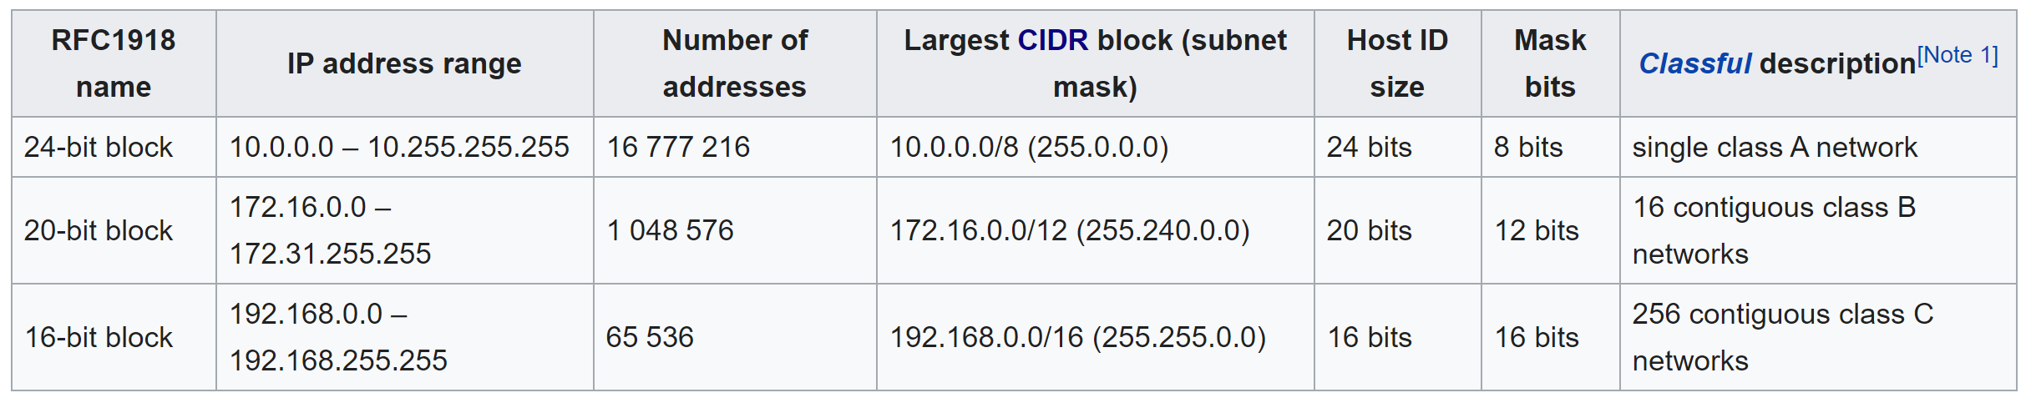
Reserved Addresses in IPv4
https://en.wikipedia.org/w/index.php?title=Private_network&oldid=991783834 (last visited Dec. 5, 2020).

Slide 5
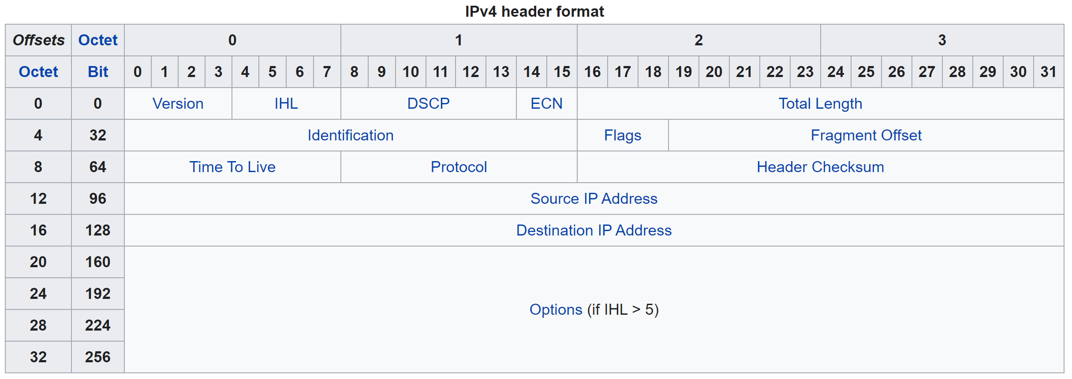
IPv4 Header
https://en.wikipedia.org/w/index.php?title=IPv4&oldid=990980009 (last visited Dec. 5, 2020).

